Slide 1



TAYM

Slide 2

TAYM is a platform that connects musicians and independent labels

Slide 3




Problem
Independent labels waste too much time looking for new artists
Artists don’t have a unique tool to be visible from labels

Slide 4
Solution
Minimize time to find new artists providing filtered search
Promotion tool to be immediately connected to labels

Slide 5




Algorithm
74,3

Slide 6
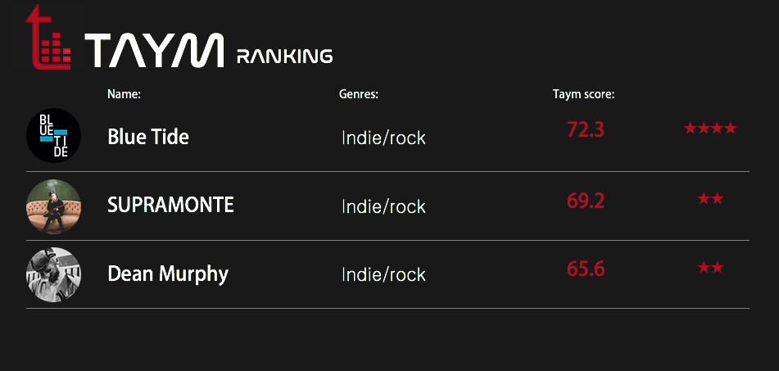

Slide 7
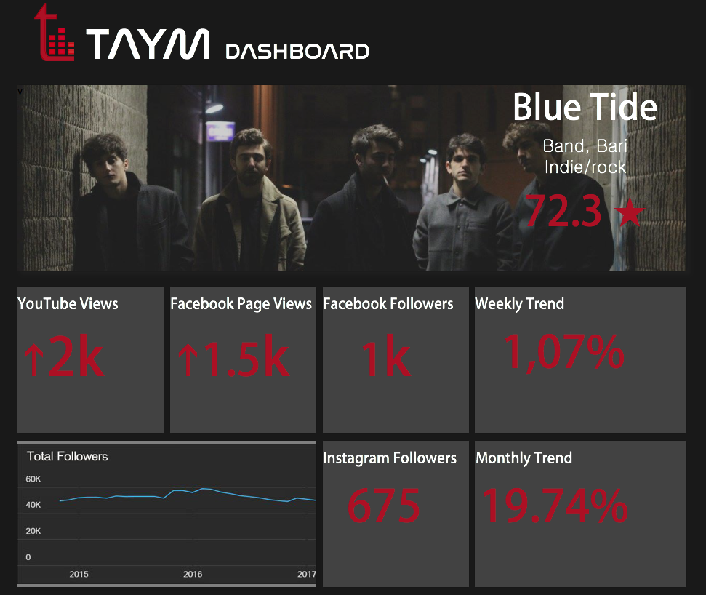

Slide 8




Competitors
Filtering
Ranking
Indie labels focus
Social Media analisys

Slide 9
Revenue model
Subscription
€ 50/ month
Free 30 days trial
Freemium
Premium
€ 5/ month

Slide 10
Financial projection
75
Italia
5 top player EU
1° year 3° year

Slide 11



Team
Giovanni Curcio
Roberto Catalano
Founder
CEO
Co-founder
Data scientist

